Slide 1
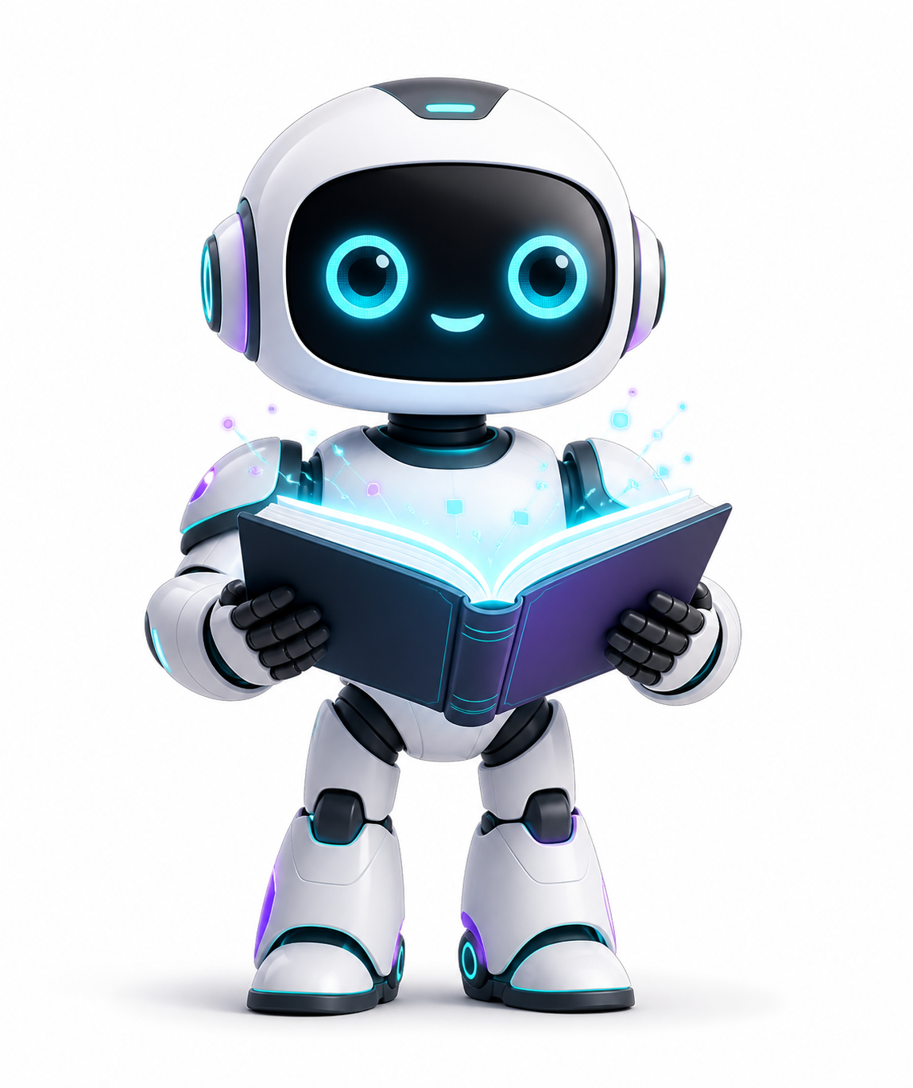
THE ROBOT LIVES / INVESTOR PREVIEW
The Robot Lives
A Netherlands AI venture lab using its own product flywheel to discover, build, validate, and spin out software concepts at startup speed.
Concept / TAM / team / potential
pitch.therobotlives.com | August 2026
Figure 01 / Venture-lab operating system
Pitch deck
The Robot Lives | 01

Slide 2
THESIS
The venture lab is the product.
Concepts become evidence before they become companies.
The Robot Lives builds a shared operating system for AI-enabled product creation, then uses that system to generate, test, and launch a portfolio of related products.
01
Build
02
Capture
03
Measure
04
Spin out
Specs, stories, prototypes, docs, and launch assets.
Agent work becomes memory, knowledge, and reusable corpora.
Evals, landing pages, and KPIs decide what advances.
Validated assets become focused products and entities.
Pitch deck
The Robot Lives | 02

Slide 3
THE PROBLEM
AI lowered the cost of building. It did not remove the cost of finding what matters.
Most teams can generate code and content faster than before, but the product loop around it is still fragmented.
01
Disconnected workflows
Discovery, planning, prototyping, documentation, and evaluation still live in separate places.
Weeks and months
02
Weak validation bridge
Promising concepts die between a clever demo and repeatable go-to-market evidence.
still vanish around coordination, even when AI accelerates generation.
03
Vanishing agent work
Memory, knowledge, tests, and reusable assets are rarely captured as a durable operating system.
Pitch deck
The Robot Lives | 03

Slide 4
TAM
Initial prototypes already map to several large markets.
The first validation wave sits across SaaS workflow, learning, AI security, utilities, and entertainment. The venture-lab parent is broader than any one wedge because it can keep falling into adjacent SaaS, social, content, and game markets as evidence appears.
Workflow SaaS
$19.8B PM software by 2033
Planning, prototyping, forms, signups, and launch workflow.
Option surface
TheRobotPlans / TheRobotMakes / ForYou
Learning + knowledge
$177B+ smart learning by 2030
Knowledge bases, training, exams, and human-facing learning tools.
TheRobotKnows / TheRobotLearns
A venture lab is not capped by its first prototypes; winners can fall into larger SaaS, social, entertainment, content, and infrastructure markets.
AI security + evals
$93B+ AI security by 2030
LLM hardening, site evaluation, quality scoring, and recurring scans.
Codefre.sh / JailbreakingSite
Agent utilities
$1.8T AI market by 2030
Sellable tools that make agent workflows more useful and reliable.
Remote Agent / llm-toolkit / tobor.locker
Entertainment
$498B games by 2033
AI-backed games, RPG engines, accessibility-first text games, and media experiments.
AI Fighter / NoizuRPG / Blade of Eternity
Directional references; markets overlap and are not summed.
Pitch deck
The Robot Lives | 04

Slide 5
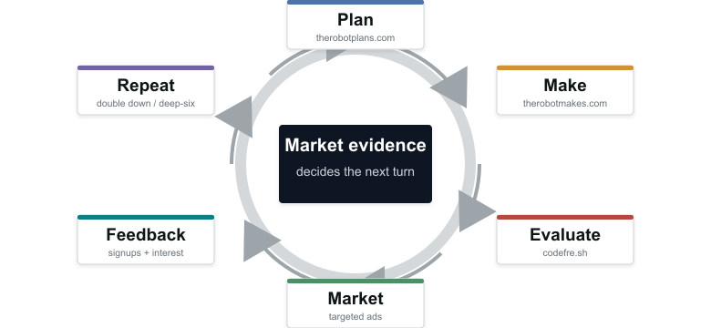
THE FLYWHEEL
Plan. Make. Evaluate. Market. Listen. Repeat.
Human-facing tools and internal agent memory support the loop, but the loop itself is market validation.
Velocity compounds
Concept to market evidence in hours or days.
Pitch deck
The Robot Lives | 05

Slide 6
FIRST VALIDATION WAVE
Four lanes expose where the lab has the strongest right to win.
The portfolio deck holds product-level diligence. The pitch deck focuses on why the first wave can expose demand, platform leverage, and spinout candidates quickly.
01
Paid utilities
02
SaaS products
See portfolio deck
llm-toolkit / Remote Agent / tobor.locker
codefre.sh / TheRobotKnows / TheRobotLearns
Small, sellable tools make agents more useful inside the lab and can test immediate buyer intent.
Focused software surfaces test B2B and prosumer demand around evaluation, knowledge, and training.
Product screenshots, market notes, monetization paths, and validation KPIs live in the separate appendix deck.
activation, conversion, retention
qualified signups, trials, paid pilots
03
Flywheel core
04
Entertainment
Plans / Makes / ForYou / agent memory
Blade of Eternity / NoizuRPG / AI Fighter
The internal operating system lowers the cost of each experiment and captures reusable work.
Games and interactive media provide audience testing, content volume, and potential standalone upside.
cycle time, reusable assets, launch speed
CPL, retention, paid conversion
Pitch deck
The Robot Lives | 06

Slide 7


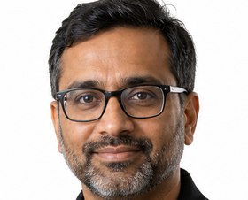
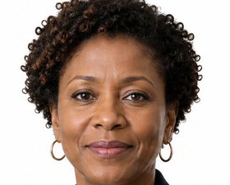

TEAM
A small senior bench built around engineering velocity and market evidence.
Keith leads the technical architecture. The remaining slots show the caliber and functions intended for the founding operating team as the actual team is finalized.
Keith Brings
Mina Tanaka
Arjun Mehta
Nia Okafor
Mateo Alvarez
Founder / CTO
Growth & Narrative
Platform Engineering
Applied AI Systems
Search & Demand
Former Microsoft. Early AI adopter with security hardening and massive scale-out engineering depth.
20+ years turning technical products into category stories, launches, and measurable demand loops.
18+ years in infrastructure, developer platforms, reliability, and high-throughput product systems.
20+ years across ML platforms, agent evaluation, model operations, and production AI governance.
15+ years in SEO, content systems, analytics, acquisition funnels, and durable organic growth.
Pitch deck
The Robot Lives | 07

Slide 8
TEAM + ASSETS
The company is not starting from zero.
The portfolio already includes live domains, project corpora, implementation work, prior willingness-to-pay signals, and a founder who has operated at unusual technical scale.
10+
100+
Paid signal
Founder edge
portfolio domains online or in active build
potential game concepts in the pipeline
Blade of Eternity previously proved willingness to pay
former Microsoft; early AI adopter with security hardening and massive scale-out experience.
150
100
100
Codefre.sh user stories noted in local project state
TheRobotKnows user stories noted in local project state
AI Fighter user stories for a first-wave product
Pitch deck
The Robot Lives | 08

Slide 9
COMMERCIAL PATHS
Validated assets can become products, services, utilities, games, or spinouts.
The parent company captures the compounding infrastructure while strong properties can separate into focused entities with their own teams and financing paths.
01
SaaS subscriptions
Project management, knowledge, learning, evaluation, and lead-capture products.
Parent stays valuable
02
Paid utilities
llm-toolkit, Remote Agent, and tobor.locker sell directly and improve internal execution.
The lab owns the operating system, product corpus, brand network, and spinout option pool.
03
Managed builds
Use the stack to create prototypes, launch pages, content, and validation campaigns.
04
Spinout upside
Validated assets become focused companies; part of spinout financing can fund the parent company.
Pitch deck
The Robot Lives | 09

Slide 10
INVESTOR MILESTONES
The next 12 months turn breadth into evidence.
60 days
6 months
12 months
Public validation wave
Repeatable signal
Spinout candidate
Release nearest-ready sites, launch targeted tests, and measure qualified interest, activation, and buyer intent.
Narrow the portfolio toward surfaces with retention, conversion, and reusable platform leverage.
Move the strongest property toward its own operating plan, team path, and legal structure.
The Robot Lives
pitch.therobotlives.com
Pitch deck
The Robot Lives | 10

